Slide 1





Numerology: Unveiling the Hidden Meanings
Numerology is a profound system that uncovers the intricate connections between numbers and our lives. By exploring the hidden meanings within these numerical patterns, we can gain profound insights into our core essence, personality, life path, and spiritual journey.
by krupesh engineer

Slide 2
Driver Number: Understanding Your Core Essence
Your driver number is a powerful numerological symbol that reveals the core of who you are. It represents your innate talents, natural strengths, and the fundamental energies that drive your life. This number provides insight into your deepest motivations, guiding you towards fulfillment and self-actualization.

Slide 3
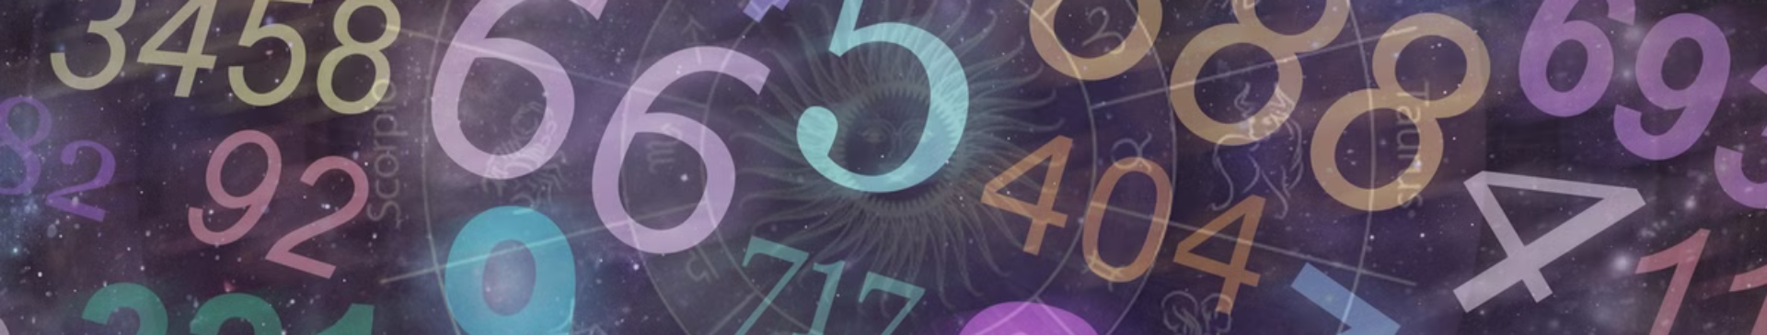
Personality Number: Revealing Your Public Persona
Your personality number is a window into how you present yourself to the world. It reflects the traits and behaviors you consciously project, shaping the impression you make on others. This number can indicate your social skills, communication style, and the ways you navigate relationships and professional settings.

Slide 4


Conductor Number: Guiding Your Life's Journey
1
Navigating Crossroads
Your conductor number serves as a guiding light, helping you navigate the crossroads and transitions in your life.
2
Orchestrating Harmony
This number influences your ability to bring different aspects of your life into harmony, ensuring a well-orchestrated journey.
3
Charting Your Course
The conductor number provides direction, empowering you to make informed decisions and chart a fulfilling life path.

Slide 5

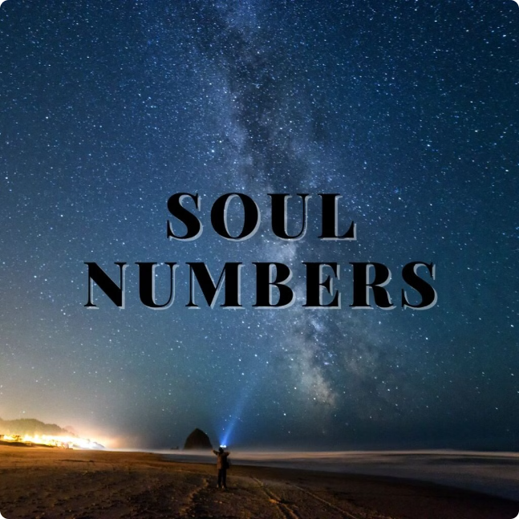
Soul Urge Number: Connecting to Your Inner Desires
Your soul urge number is a powerful numerological force that reveals your deepest longings and innate spiritual yearnings. This number illuminates the authentic desires that fuel your life's journey, guiding you towards fulfillment and self-actualization. By understanding your soul urge, you can unlock the keys to aligning your actions with your innermost passions.

Slide 6


Interpreting the Numbers: A Holistic Approach
Numerology is a multifaceted science that requires a comprehensive understanding to unlock its profound insights. By examining the interconnectedness of the various numerical influences in your life, you can gain a holistic perspective that guides you towards self-discovery and personal growth.
Each numerical element, from the driver number to the soul urge number, contributes a unique piece to the puzzle of your identity. Interpreting these numbers through a balanced and intuitive lens empowers you to make more informed decisions, navigate life's challenges with greater clarity, and align your actions with your deepest aspirations.

Slide 7
Unlocking the Power of Numerology
Numerology is a profound system that unveils the hidden meanings within the numerical patterns of your life. By tapping into this ancient wisdom, you can unlock transformative self-knowledge and chart a course towards fulfillment.
Uncover Your Unique Numerical Essence: Explore the intricate interplay of your driver, personality, conductor, soul urge, and maturity numbers to reveal your core identity.
Align Your Decisions with Your Deeper Calling: Let the insights from numerology guide you in making choices that resonate with your innermost desires and life purpose.
Enhance Your Relationships and Interactions: Gain deeper understanding of yourself and others through the lens of numerology, fostering more meaningful connections.

Slide 8
Renowned Numerologists
Linda Goodman
1
Pioneering astrologer and numerologist, known for her best-selling books that introduced numerology to mainstream audiences.
2
Glynis McCants
Contemporary expert on numerology, appearing on TV and radio to share insights on using numbers to better understand oneself and others.
Stacey Wolf
3
Acclaimed author and numerologist, combining ancient wisdom with modern psychology to help individuals unlock their full potential.

Slide 9
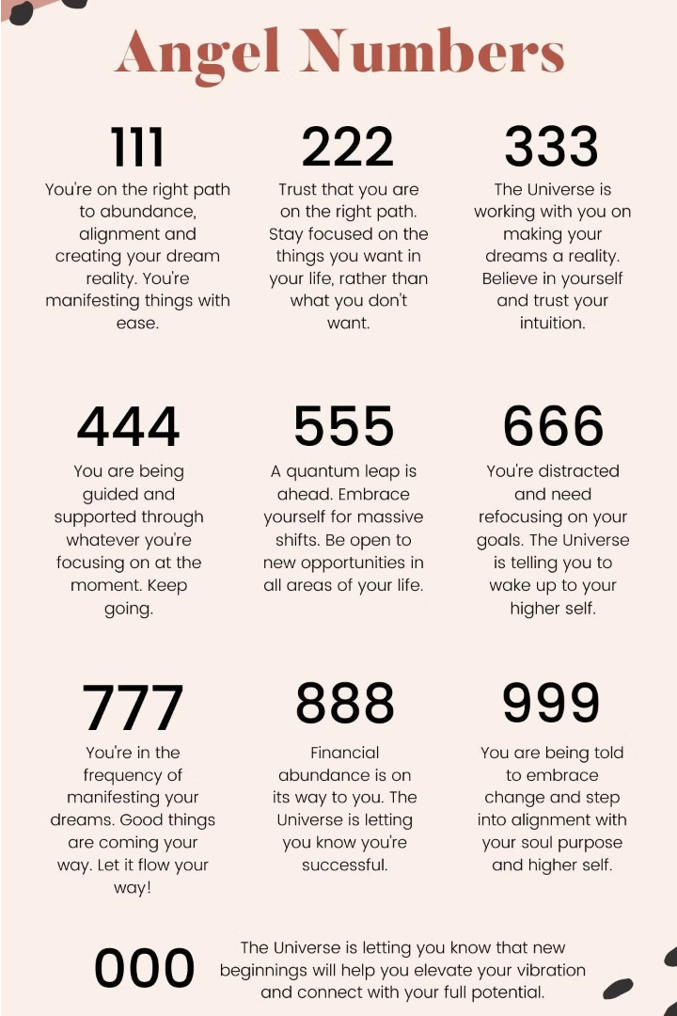
Applying Numerology to Your Life
Numerology is more than just an intellectual pursuit - it's a powerful tool for personal growth and transformation. By integrating the insights of your unique numerical profile into your daily life, you can unlock a deeper understanding of yourself and make more aligned decisions.
Whether it's leveraging your driver number to forge a fulfilling career path, harnessing your personality number to enhance your relationships, or following the guidance of your conductor number to navigate life's crossroads, numerology provides a roadmap for living an authentic, purpose-driven existence.

Slide 10

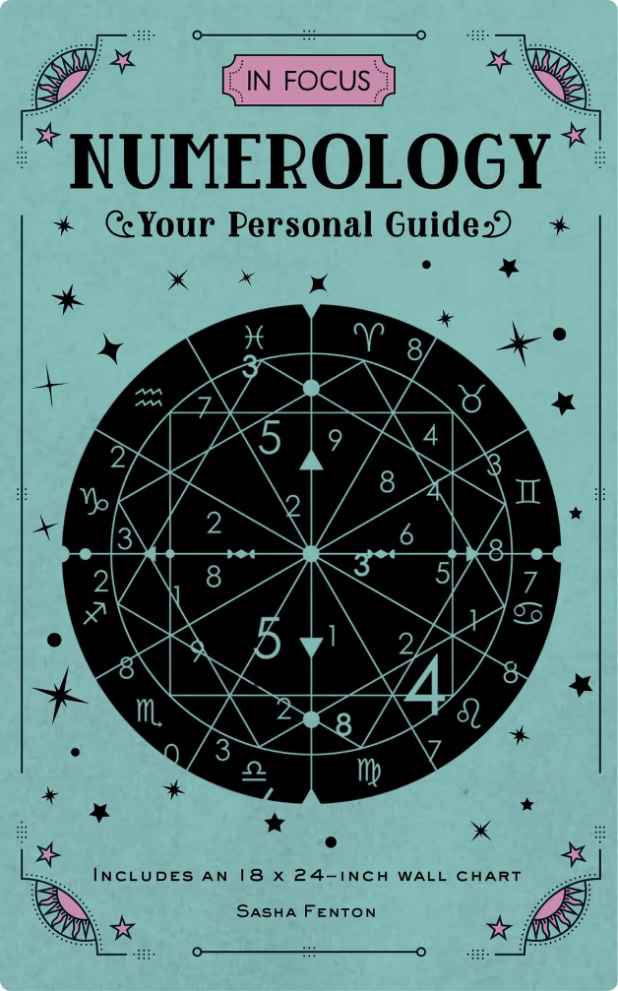
Discovering Your Unique Numerological Profile
Your numerological profile is a tapestry of insights that unveils the intricate patterns underlying your life. By exploring the harmony and interplay of your driver, personality, conductor, soul urge, and maturity numbers, you can unlock a profound understanding of your true self.
Embrace this holistic journey of self-discovery, and let the wisdom of numerology guide you towards living an authentic, purpose-driven existence that aligns with your deepest aspirations.

